Slide 1
Can Cross Language Brain Decoding work ?
Team : Dil Ke Nawab
Harshit Sharma (2019101083)
Shreyash Rai (2019101096)

Slide 2
Introduction
The approach of cross-language brain decoding is to use models of brain decoding from one language to decode stimuli of another language. It has the potential to provide new insights into how our brain represents multiple languages. The cross-language brain decoding approach provides a new and powerful direction to address the issue of how two or more languages are encoded through shared and distinct neural activities in the brain. These studies have significant practical implications for bilingual education and foreign language instruction. However, so far it is unclear whether and how cross-language brain decoding works, given the extant evidence. In single language brain decoding, neural responses to linguistic materials are recorded with neuroimaging methods, such as functional magnetic resonance imaging (fMRI) and magnetoencephalography (MEG) and a computational model is trained to map between brain activity and stimulus-specific linguistic features.

Slide 3
Earlier Approaches and Findings
A number of recent studies have demonstrated that it is possible to reliably decode semantic information at the word level across different languages from neuroimaging data using machine learning methods.Multivariate pattern analysis (MVPA) has been used in cross-language decoding with increasing popularity. Compared to the traditional univariate method which examines brain voxels in isolation, MVPA takes into account the relationships across multiple voxels and has the potential to decode fine-grained patterns of brain activity. Bilinguals are usually recruited as participants in cross-language brain decoding studies and the same participants need to receive stimuli (words) from both languages (consecutively) while their brain responses are collected during the processing of these stimuli.

Slide 4
Participant | Mean Age | AoA | Proficiency in L2 | Method | Stimuli and task | Cross-language decoding accuracy
11 Portuguese-English BI | 29.9 | 13.08 | Proficient (Self-rated) | fMRI; MVPA | Concrete nouns; Thinking about the properties of nouns | English → Portuguese 0.68, Portuguese → English 0.72 (CL 0.5)
10 Dutch-English BI | 25.4 | – | Proficient (LexTALE*) | fMRI; MVPA | Concrete nouns; Pressing a button when they hear an inanimate noun | Above chance (CL 0.5)
16 Dutch-English BI | 28.9 | – | Proficient (LexTALE) | EEG; MVPA | Concrete nouns; Pressing a button when hear an inanimate noun | Above chance during 550–600 ms after word onset (CL 0.5)

Slide 5
11 English native speakers and 11 Chinese-English BI | – | – | – | fMRI; MVPA | Concrete nouns; Determining whether the noun was semantically related to the preceding word | The accuracy reached 1.0 for some ROIs (CL 0.5)
24 Dutch-French BI | 23.4 | 0 for early BI, 9 for late BI | Different levels of proficiency (LexTALE, BNT** and self-rating) | fMRI; MVPA | Pictures; Naming the pictures | 0.110 (CL 0.1)
22 Dutch-French BI | 23.6 | 0 for early BI, 9 for late BI | Different levels of proficiency (LexTALE, BNT and self-rating) | fMRI; MVPA | Pictures and concrete nouns; Naming the pictures and determining the properties of the concepts | Above chance (CL 0.1)

Slide 6
30 Spanish-Basque BI | 24.2 | 0.24 for Spanish, 1.17 for Basque | Proficient, more proficient in Spanish (LexTALE, BEST***) | fMRI; MVPA | Words; Shallow processing task: reading and attending to the word; Deep processing task: thinking about the properties of the word | Deep processing: Spanish → Basque 0.550, Basque → Spanish 0.548, shallow processing: chance-level (CL 0.5)
24 Spanish-Basque BI | 22.3 | 0.52 for Spanish, 1.05 for Basque | Proficient; more proficient in Spanish (LexTALE, BEST) | fMRI; MVPA | Words; Determining whether the word was animate or inanimate and rating the awareness of the word | Non-conscious trials: CL, partially conscious trials: CL (CL 0.5)
8 Portuguese-English BI and 7 Portuguese MO | 28.1 | 12.9 | Highly proficient (adapted TOEFL) | fMRI; semantic features | Sentences; Thinking about the properties of each phrase | English → Portuguese 0.67 (CL 0.5)

Slide 7
7 English MO, 4 Portuguese MO, 3 Portuguese-English BI and 7 Mandarin-English BI | 24.7 | – | – | fMRI; semantic features | Sentences; thinking about the sentences | Two-to-one mappings 0.668 on average, one-to-one mappings 0.624 on average (CL 0.5)
30 English MO, 30 Chinese-English BI and 30 Farsi-English BI | 24.7 | – | Fluent | fMRI; story-level embeddings (doc2vec) | Narrative stories; Reading the stories | One-to-one mappings 0.561 on average (CL 0.5)

Slide 8
More Findings
This broad timeline for within-language decoding and narrow time window for cross-language decoding could be explained by the different mechanisms underlying decoding: within-language decoding relies on the initial phonetic-phonological processing and the subsequent lexical semantic processing, whereas cross-language decoding could rely on the shared semantic-conceptual properties of the word across languages, therefore occurring within a narrow but fast time window. Cross-language decoding success in bilinguals reported in the above studies reflects the common neural representation of word meanings across two languages. However, since the participants recruited in these studies were proficient bilinguals who know the words in both languages very well, it is likely that cross-language decoding results for monolinguals might not be that good.

Slide 9
Cross Language Similarity
Cross Language Similarity is the distance or similarity between the two languages, which may involve systematic differences in vocabulary, grammar, phonology, script, and other characteristics. Understanding the extent to which there are shared or different aspects across languages is an essential step in addressing the possible influences of language properties and linguistic experience on cross-language brain decoding. Thereby, we selected English and Spanish for our project. To begin with the linguistic similarities between English and Spanish, the most evident one is that they both share the same alphabet: the Latin alphabet. They also share a few words rooted in the old Latin and Greek languages, which greatly simplifies the comprehension of many words from the other language. For example, the words photography and fotografía, or biology and biología. These words with similar sound and meaning are called “cognates,” and comparative linguistics tells us that there are plenty of them between English and Spanish. Between 30% and 40% of English words have a related word in Spanish.

Slide 10
Dataset and Information
For our task, we took a dataset from OpenNeuro. In the dataset, adult bilingual speakers (both Spanish and English) are given to read 1000 English words and their brain signals(fMRI) are recorded. Afterwards, they are given translation of these 1000 English words to Spanish and their brain(fMRI) signals are recorded. Now, we took signals of a single subject. Now we word code different brain encoding for these signals. For both english->spanish and spanish->english.

Slide 11
Approach 1 (Basic Approach)
In the first approach, we mapped the words to indexes using a dictionary, then using the English brain signals and indexes of english words, we trained the Linear regression model.We predicted the indexes of spanish from spanish brain signals, then calculated r2 scores and mean squared error for the same. For more better results , we used regularization and used both ridge and lasso regression for the same.The results we got were :
Linear Regression : R2 Score -> 0.68 Mean Squared Error -> 15.383
Lasso Regression : R2 Score-> 0.82 Mean Squared Error -> 18
Ridge Regression : R2 Score -> 0.61 Mean Squared Error -> 15

Slide 12
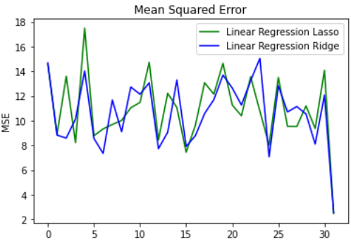
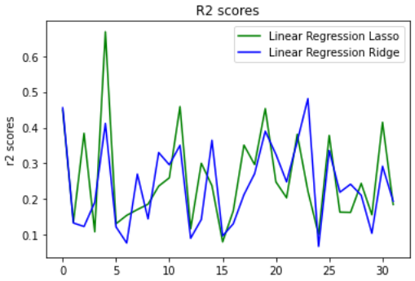
Observations
Mean Squared Error
R2 Scores

Slide 13
Approach 2
We got to know that indexes would not be a good measure to tokenize the words. So this time we wanted to do something with word embeddings. So, we used bert model of distiluse-base-multilingual-cased-v2, this is a multi-language bert embedding model. This is suitable with both English and Spanish. So we encoded our words using this bert model. After applying this, each words was mapped to 512 dimensional dense vector space. Now, we would this for our model training. We also changed our score metrics. For approach 2, we are calculating 2V2 Accuracy and Pearson Correlation, to check how good our model would perform.

Slide 14
2V2 Accuracy and Pearson Correlation
Now 2v2 Accuracy is calculated as follows :
1/^{N}C₂ * ΣΣ I[{cosD(y_test_{i} ,y_pred_{i}) + cosD(y_test_{j} ,y_pred_{j})} < {cosD(y_test_{i} ,y_pred_{j}) + cosD(y_test_{j} ,y_pred_{i})}]
Next we are calculating Pearson Correlation :
Pearson Correlation = 1/N * Σ corr[y_test, y_pred]
The Pearson correlation measures the strength of the linear relationship between two variables. It has a value between -1 to 1, with a value of -1 meaning a total negative linear correlation, 0 being no correlation, and + 1 meaning a total positive correlation.

Slide 15
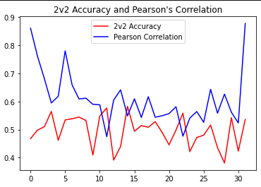
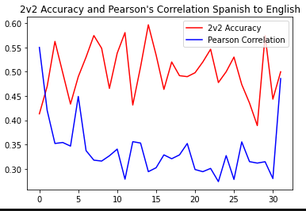
Applying Ridge Regression (En -> Sp & Sp -> En)
This is English to Spanish model using ridge regression, we could see that Pearson correlation factor is 0.9123, this means the results are highly correlated and 2V2 Accuracy is 0.782. The model performed pretty well.
This is Spanish to English model using ridge regression, we could see that Pearson correlation factor is 0.55, this means the results are medium correlated and 2V2 Accuracy is 0591. The En->Sp model performed better that Sp->En model.

Slide 16
Random Forest Regressor
Random Forest Regression is a supervised learning algorithm that uses ensemble learning method for regression. Ensemble learning method is a technique that combines predictions from multiple machine learning algorithms to make a more accurate prediction than a single model. Therefore, we used random forest regressor with max_depth= 2 and max_depth=None for our model. This would give more good values than a single ridge regressor.
Random Forest (Max_depth = 2 , En->Sp) : 2v2 Accuracy-> 0.62 , Pearson Correlation -> 0.81
Random Forest (Max_depth = None , En->Sp) : 2v2 Accuracy-> 0.63 , Pearson Correlation -> 0.82
Random Forest (Max_depth = None , Sp->En) : 2v2 Accuracy-> 0.59 , Pearson Correlation -> 0.84

Slide 17
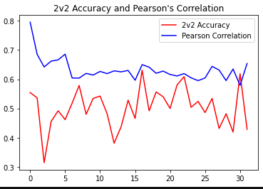
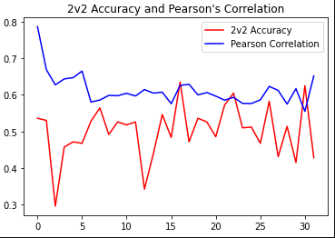
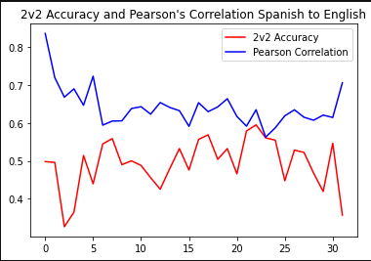
Observations
Rf , Max_depth = 2 , En->Sp
Rf, Max_depth= None , En->Sp
Rf, Max_depth=None, Sp->En

Slide 18
Bagging Regressor
A Bagging regressor is an ensemble meta-estimator that fits base regressors each on random subsets of the original dataset and then aggregate their individual predictions (either by voting or by averaging) to form a final prediction. We need to use different regression techniques and thought that bagging would combine different prediction on multiple datasets our data.
Bagging Regressor(n_estimators = 50 , En->Sp) : 2V2 Accuracy-> 0.71 , Pearson Correlation-> 0.8
Bagging Regressor(n_estimators = 100 , En->Sp) : 2V2 Accuracy-> 0.75 , Pearson Correlation-> 0.83
Bagging Regressor(n_estimators = 100 , Sp->En) : 2V2 Accuracy-> 0.63 , Pearson Correlation-> 0.82

Slide 19
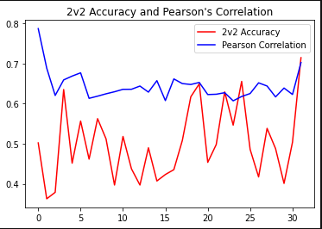
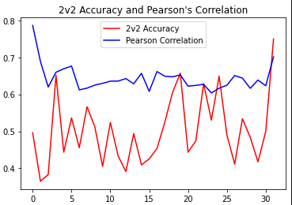
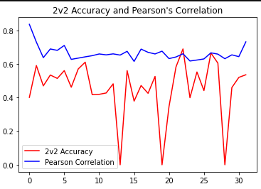
Observation
Bg, n_estimators=50,En->Sp
Bg, n_estimators=100,En->Sp
Bg, n_estimators=100,Sp->En

Slide 20
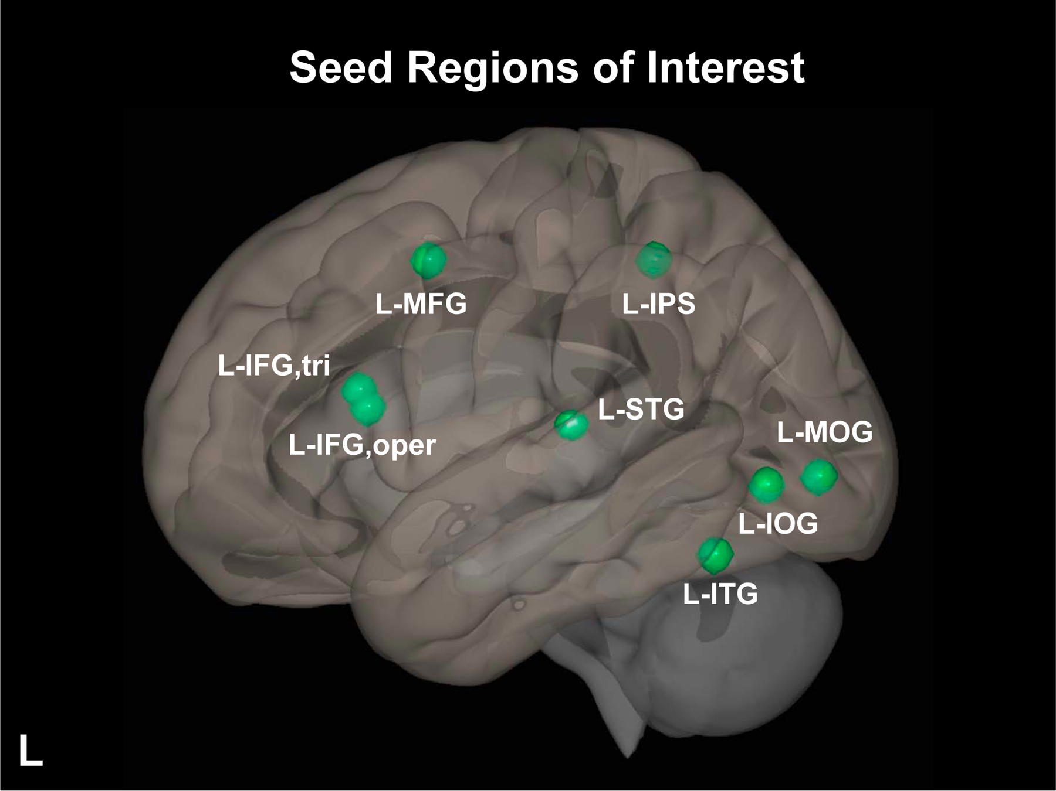
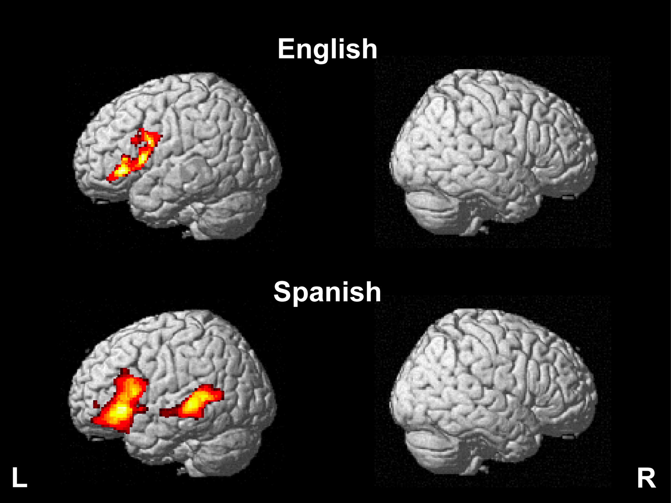
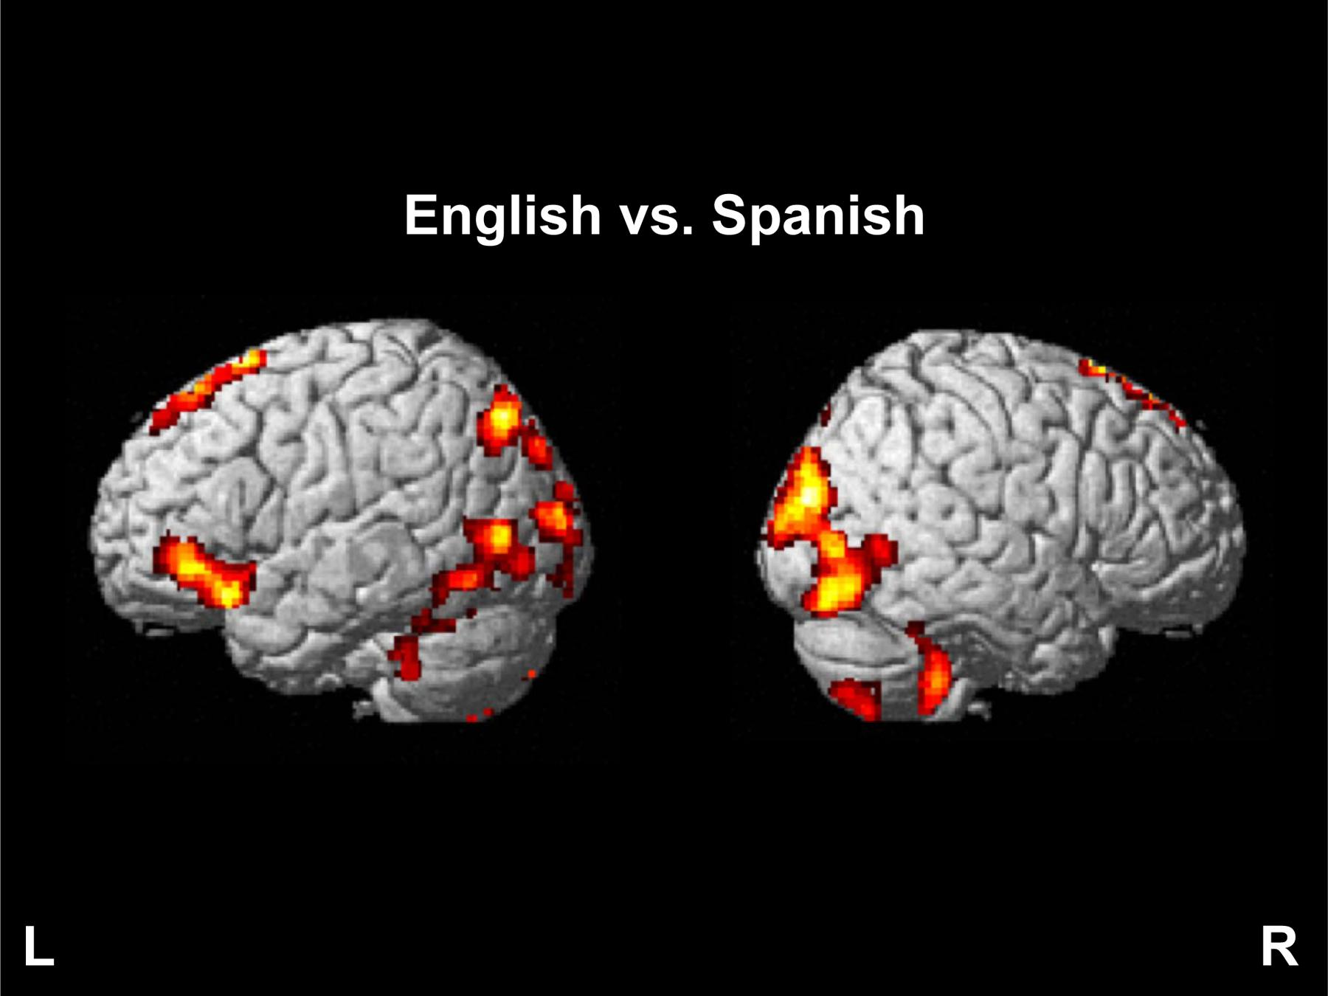
Single-word reading in both the deep (English) and the shallow (Spanish) orthography engages the left inferior frontal cortex. English and Spanish word reading were found to be differently represented in several regions of the brain. These results suggest that word processing in alphabetic languages of different orthographic depth does not engage language-specific brain activity locally, or functional connectivity between regions supporting reading, but manifests as distinct neural representations in Spanish-English early bilingual adults.

Slide 21
Conclusion
Brain decoding has been an exciting and rapidly developing topic in this regard. Cross-language brain decoding has the potential to pro­vide new insights into how our brain represents multiple languages.Our work only considered basic machine learning algorithms in the brain decoding task.We could also use advanced algos as MVPA(Multivariate Pattern Analysis) etc. for better results. Moreover, if data is available, we could also work on monolinguals rather than bilinguals, which could be an important field to explore.cross-language brain decoding indicates that it is possible to decode semantic information across different languages from neuroimaging data, but there are also significant challenges to its success. Factors such as cross-language similarity, AoA/proficiency levels, depth of language processing may all affect the effectiveness of cross-language decoding.

Slide 22
Thank You

